Slide 1
TRIMIT
Master & Item Structure

Slide 2
Introduction
Fashion Intelligent number
Furniture/Configuration Generic number
Furniture/Configuration Sequential number
Furniture Structure in Demo Sites

Slide 3
Introduction
In this presentation, you will find the structure of the different Types of Items based on the Master:
  Intelligent Item Number
  Generic Item Number
  Sequential Item Number
In this presentation, you will also find the structure (BOMs) of the Furniture Masters that we have in our TRIMIT Demo Sites, therefore easy to use for your demos.

Slide 4
Fashion
Intelligent

Slide 5
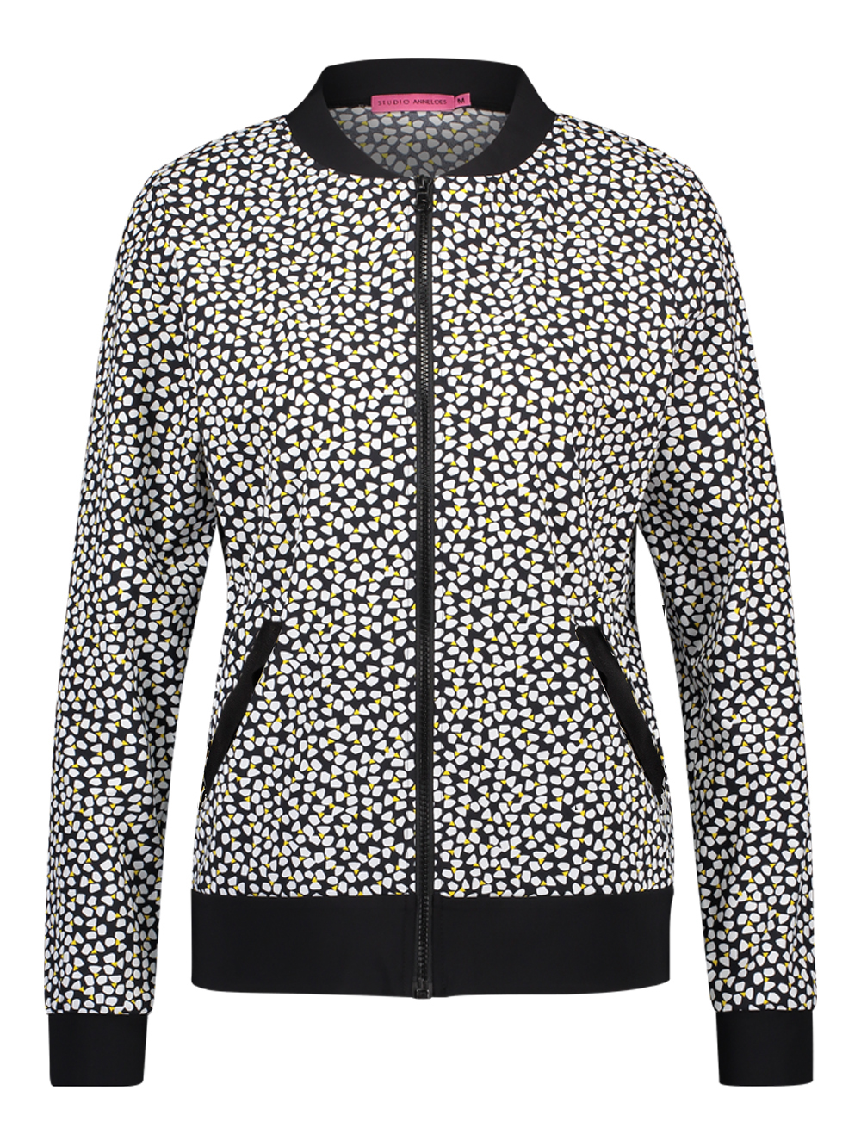
Master & Item Structure – Intelligent
Master 2200
Jacket

Slide 6
Master & Item Structure – Intelligent
VarDim Types are selected in the VarDim Master
Color Table
10
White
20
Blue
30
Yellow
40
Brown
50
Sand
60
Green
Master 2200
Jacket
70
Red
80
Purple
90
Grey
92
Charcoal
99
Black
Size Table
36
36
38
38
40
40
42
42
44
44
46
46
48
48

Slide 7
Master & Item Structure – Intelligent
VarDim Types are selected in the VarDim Master
Valid options are selected
Color Table
Valid Color Options
10
White
10
White
20
Blue
20
Blue
30
Yellow
30
Yellow
40
Brown
40
Brown
50
Sand
50
Sand
60
Green
60
Green
Master 2200
Jacket
70
Red
70
Red
80
Purple
80
Purple
90
Grey
90
Grey
92
Charcoal
92
Charcoal
99
Black
99
Black
Size Table
Valid Size Options
36
36
36
36
38
38
38
38
40
40
40
40
42
42
42
42
44
44
44
44
46
46
46
46
48
48
48
48

Slide 8
Master & Item Structure – Intelligent
VarDim Types are selected in the VarDim Master
Valid options are selected
No. System
Description
Posting Groups
Pricing
Cost method
Calculation
PDM
Item Statistics Group
Color Table
Valid Color Options
10
White
10
White
20
Blue
20
Blue
30
Yellow
30
Yellow
40
Brown
40
Brown
50
Sand
50
Sand
60
Green
60
Green
Master 2200
Jacket
70
Red
70
Red
80
Purple
80
Purple
90
Grey
90
Grey
92
Charcoal
92
Charcoal
99
Black
99
Black
Size Table
Valid Size Options
36
36
36
36
38
38
38
38
40
40
40
40
42
42
42
42
44
44
44
44
46
46
46
46
48
48
48
48

Slide 9
Master & Item Structure – Intelligent
Item Nos. are combination of Master No + Variant Codes
VarDim Types are selected in the VarDim Master
Valid options are selected
No. System
Description
Posting Groups
Pricing
Cost method
Calculation
PDM
Item Statistics Group
2200 40 36
Jacket – Brown, size: 36
Color Table
Valid Color Options
10
White
10
White
20
Blue
20
Blue
2200 40 38
Jacket – Brown, size: 38
30
Yellow
30
Yellow
40
Brown
40
Brown
50
Sand
50
Sand
2200 40 40
Jacket – Brown, size: 40
60
Green
60
Green
Master 2200
Jacket
70
Red
70
Red
80
Purple
80
Purple
90
Grey
90
Grey
92
Charcoal
92
Charcoal
2200 90 36
Jacket – Grey, size: 36
99
Black
99
Black
2200 90 38
Jacket – Grey, size: 38
Size Table
Valid Size Options
36
36
36
36
38
38
38
38
2200 90 40
Jacket – Grey, size: 40
40
40
40
40
42
42
42
42
44
44
44
44
46
46
46
46
48
48
48
48

Slide 10
Master & Item Structure – Intelligent
Information that is changed per item:
Items are created automatically from selected combinations
VarDim Types are selected in the VarDim Master
Valid options are selected
No. System
Description
Posting Groups
Pricing
Cost method
Calculation
PDM
Item Statistics Group
Pricing
Unit Cost
Vendor Item No.
2150 40 36
Jacket – Brown, size: 36
Color Table
Valid Color Options
10
White
10
White
20
Blue
20
Blue
2150 40 38
Jacket – Brown, size: 38
30
Yellow
30
Yellow
40
Brown
40
Brown
50
Sand
50
Sand
2150 40 40
Jacket – Brown, size: 40
60
Green
60
Green
Information you can see per Item:
Master 2150
Jacket
70
Red
70
Red
80
Purple
80
Purple
90
Grey
90
Grey
92
Charcoal
92
Charcoal
Qty. on Inventory
Qty. in Sales Orders
Qty. in Purchase Orders
Available Quantity
Vendor Item No.
Unit Cost
Last Purchase Price
Etc.
2150 90 36
Jacket – Grey, size: 36
99
Black
99
Black
2150 90 38
Jacket – Grey, size: 38
Size Table
Valid Size Options
36
36
36
36
38
38
38
38
2150 90 40
Jacket – Grey, size: 40
40
40
40
40
42
42
42
42
44
44
44
44
46
46
46
46
48
48
48
48

Slide 11
Master & Item Structure – Intelligent
Information that is changed per item:
Items are created automatically from selected combinations
VarDim Types are selected in the VarDim Master
Valid options are selected
No. System
Description
Posting Groups
Pricing
Cost method
Calculation
PDM
Item Statistics Group
Pricing
Unit Cost
Vendor Item No.
2150 40 36
Jacket – Brown, size: 36
Color Table
Valid Color Options
10
White
10
White
20
Blue
20
Blue
2150 40 38
Jacket – Brown, size: 38
30
Yellow
30
Yellow
40
Brown
40
Brown
50
Sand
50
Sand
2150 40 40
Jacket – Brown, size: 40
60
Green
60
Green
Information you can see per Item:
Master 2150
Jacket
70
Red
70
Red
80
Purple
80
Purple
90
Grey
90
Grey
92
Charcoal
92
Charcoal
Qty. on Inventory
Qty. in Sales Orders
Qty. in Purchase Orders
Available Quantity
Vendor Item No.
Unit Cost
Last Purchase Price
Etc.
2150 90 36
Jacket – Grey, size: 36
99
Black
99
Black
2150 90 38
Jacket – Grey, size: 38
Master BOM
Size Table
Valid Size Options
36
36
36
36
38
38
38
38
2150 90 40
Jacket – Grey, size: 40
40
40
40
40
42
42
42
42
44
44
44
44
46
46
46
46
48
48
48
48
Temporary BOM

Slide 12
Furniture/Configuration
Generic Number

Slide 13
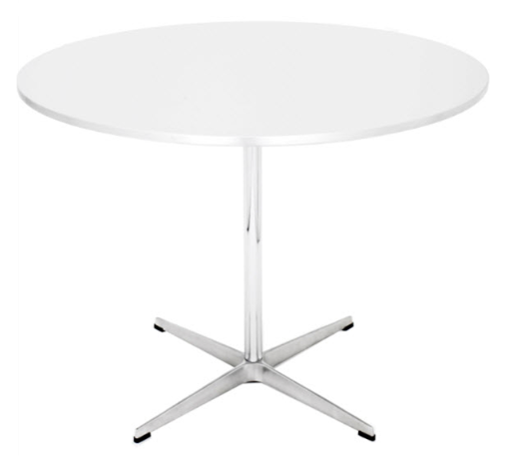
Master & Item Structure - Generic
Master 5100
Table

Slide 14
Master & Item Structure - Generic
VarDim Types are selected in the VarDim Master
Variant Table: Wood
10
Ash
20
Oak
30
Beech
40
Walnut
Master 5100
Table
Variant Table: Base
A
Standard X
B
Arched X
C
Four Columns X
D
Disc
Dimension Diameter

Slide 15
Master & Item Structure - Generic
VarDim Types are selected in the VarDim Master
Valid options and min./max values are selected
Variant Table: Wood
Valid Options Wood
10
Ash
10
Ash
20
Oak
20
Oak
30
Beech
30
Beech
40
Walnut
40
Walnut
Master 5100
Table
Variant Table: Base
Valid Options Base
A
Standard X
A
Standard X
B
Arched X
B
Arched X
C
Four Columns X
C
Four Columns X
D
Disc
D
Disc
Dimension Diameter
Range Diameter
Min
500 mm
Max
2000 mm
Valid Options can be set via:
Positive List : Include Options
Negative List : Excluding Options
Overall/Subordinate : Valid Combinations

Slide 16
Master & Item Structure - Generic
No. System
Description
Posting Groups
Pricing
Cost method
Item Statistics Group
Planning Parameters
Etc.
VarDim Types are selected in the VarDim Master
Valid options and min./max values are selected
Variant Table: Wood
Valid Options Wood
10
Ash
10
Ash
20
Oak
20
Oak
30
Beech
30
Beech
40
Walnut
40
Walnut
Master 5100
Table
Variant Table: Base
Valid Options Base
A
Standard X
A
Standard X
B
Arched X
B
Arched X
C
Four Columns X
C
Four Columns X
D
Disc
D
Disc
Dimension Diameter
Range Diameter
Min
500 mm
Max
2000 mm

Slide 17
Master & Item Structure - Generic
No. System
Description
Posting Groups
Pricing
Cost method
Calculation
PDM
Item Statistics Group
VarDim Types are selected in the VarDim Master
Valid options and min./max values are selected
Variant Table: Wood
Valid Options Wood
10
Ash
10
Ash
20
Oak
20
Oak
30
Beech
30
Beech
40
Walnut
40
Walnut
Master 5100
Table
Variant Table: Base
Valid Options Base
A
Standard X
A
Standard X
B
Arched X
B
Arched X
C
Four Columns X
C
Four Columns X
Master BOM
D
Disc
D
Disc
Dimension Diameter
Range Diameter
Min
500 mm
Max
2000 mm

Slide 18
Master & Item Structure - Generic
No. System
Description
Posting Groups
Pricing
Cost method
Calculation
PDM
Item Statistics Group
VarDim Types are selected in the VarDim Master
Valid options and min./max values are selected
Sales Order
Line
Variant Table: Wood
Valid Options Wood
10
Ash
10
Ash
20
Oak
20
Oak
30
Beech
30
Beech
40
Walnut
40
Walnut
Item 5100
Table
Master 5100
Table
Variant Table: Base
Valid Options Base
A
Standard X
A
Standard X
B
Arched X
B
Arched X
C
Four Columns X
C
Four Columns X
Master BOM
D
Disc
D
Disc
Dimension Diameter
Range Diameter
Min
500 mm
Max
2000 mm
For all Configurations:
Item No.: 5100

Slide 19
Master & Item Structure - Generic
No. System
Description
Posting Groups
Pricing
Cost method
Calculation
PDM
Item Statistics Group
VarDim Types are selected in the VarDim Master
Valid options and min./max values are selected
Sales Order
Line
Variant Table: Wood
Valid Options Wood
10
Ash
10
Ash
20
Oak
20
Oak
30
Beech
30
Beech
40
Walnut
40
Walnut
Item 5100
Table
Master 5100
Table
Variant Table: Base
Valid Options Base
A
Standard X
A
Standard X
B
Arched X
B
Arched X
C
Four Columns X
C
Four Columns X
Temporary BOM
Master BOM
D
Disc
D
Disc
Dimension Diameter
Range Diameter
Min
500 mm
Max
2000 mm
Component Lines
Related Prod. Order

Slide 20
Furniture/Configuration
Sequential Number

Slide 21
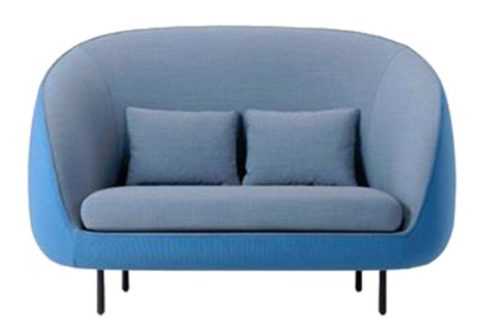
Master and Item Structure – Sequential No.
No. System
Description
Posting Groups
Pricing
Cost method
Calculation
PDM
Item Statistics Group
All kinds of selections for VarDim Types
in the
VarDim Master
Master 5200
Sofa
Master BOM

Slide 22
Master and Item Structure – Sequential No.
No. System
Description
Posting Groups
Pricing
Cost method
Calculation
PDM
Item Statistics Group
Item 520000001
Sofa
Configuration 1
All kinds of selections for VarDim Types
in the
VarDim Master
Item 5200000002
Sofa
Configuration 2
Master 5200
Sofa
Item 5200000003
Sofa
Configuration 3
Master BOM

Slide 23
Master and Item Structure – Sequential No.
No. System
Description
Posting Groups
Pricing
Cost method
Calculation
PDM
Item Statistics Group
Item 520000001
Sofa
Configuration 1
All kinds of selections for VarDim Types
in the
VarDim Master
Item 5200000002
Sofa
Configuration 2
Master 5200
Sofa
Item 5200000003
Sofa
Configuration 3
Master BOM
Temporary BOM

Slide 24
Types of Items

Slide 25
Master - Introduction
Master is Level above the BC Item
Also called:
  Model
  Style
  Etc.
Master = Item Template
VarDim Master = Set of Questions
VarDim Item = Set of Answers on Item Level
VarDim Order = Set of Answers on Order Level
Matrix = X-Axis (Columns) with one Variant, Y-Axis (Lines) with combinations of other Variants
Item Data will be maintained from the Master.

Slide 26
Master – Item – SKU
Master
Item 1
Item 2
Item 3
SKU1:
Item 1
Location 1
SKU2:
Item 1
Location 2
SKU3:
Item 2
Location 1
SKU4:
Item 2
Location 2
SKU5:
Item 3
Location 1
SKU6:
Item 3
Location 2

Slide 27
Item Numbering
  Characters in No. System are related to the value in the field:
  VarDim Type Placement in Item No.
  The number of characters corresponds with the number of digits of the Variant Code or maximum of Dimension
  M Stands for Master Number
  A Stands for Variant 1 in the VarDim Master
  B Stands for Variant 2 in the VarDim Master
  C Stands for Variant 3 in the VarDim Master
  D Stands for Variant 4 in the VarDim Master
  E Stands for Variant 5 in the VarDim Master
  F Stands for Variant 6 in the VarDim Master
  G Stands for Variant 7 in the VarDim Master
  H Stands for Variant 8 in the VarDim Master
  I Stands for Variant 9 in the VarDim Master
  1 Stands for Dimension 1 in the VarDim Master
  2 Stands for Dimension 2 in the VarDim Master
  3 Stands for Dimension 3 in the VarDim Master
  L Stands for Sequential Number

Slide 28
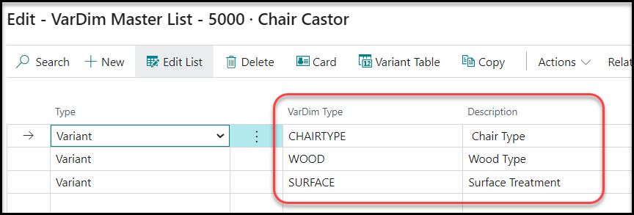
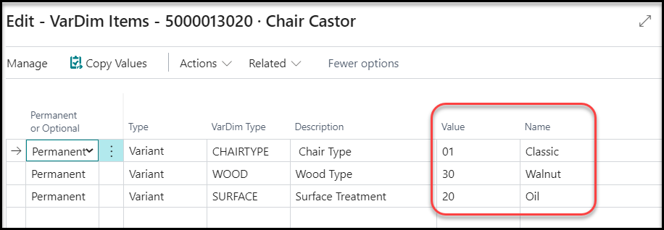
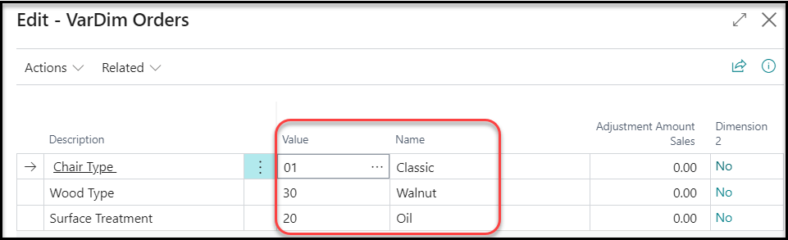
VarDim Definitions
VarDim Master : Set of Questions
VarDim Item : Set of Answers (Item)
VarDim Order : Set of Answers (Order)

Slide 29
Item Numbering
Items configured from Master.
4 Types of Item Numbers:
Generic Number : Item No. = Master No.
All Items with different Configurations have identical Number.
Intelligent Number : Item No. = Master No. + Option Codes
Item No. is Unique and includes the Variants and/or Dimensions
Sequential Number : Item No. = Master No. + Seq. No.
Item No. is Unique, but it does not say anything regarding the configuration choices
Combination of the above

Slide 30
Furniture Structure in TRIMIT Demo Sites

Slide 31
White Material Text = Purchase-/Production Materials that are inventory based
Yellow Material Text = Purchase-/Production Materials that will get a Related Order Instantly
Orange Material Text = Purchase-/Production Materials that are order based

Slide 32
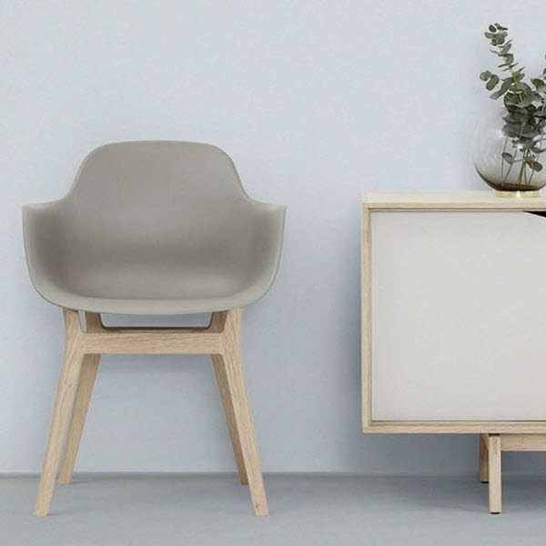
Chair Zeus
3000
Chair Zeus
Molded Chair Seat
Chair Frame - Bottom
Mount
M3000
M3015
300050

Slide 33

Chair Hades
3010
Chair Hades

Slide 34
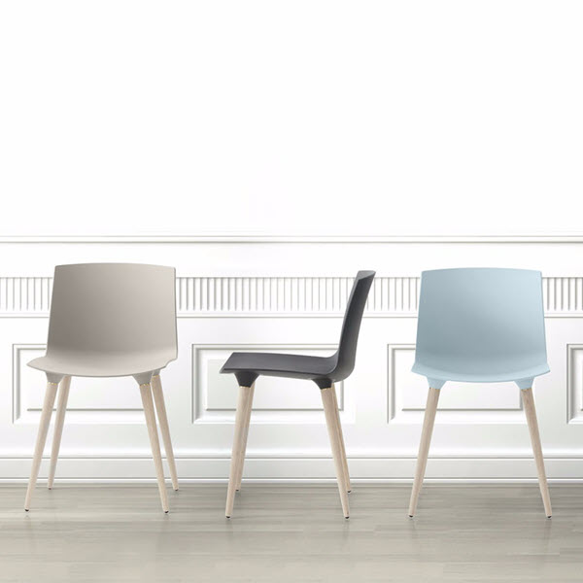
Chair Poseidon
3020
Chair Poseidon
Molded Chair Seat
Chair Legs
Mount
M3000
M3010
300050

Slide 35
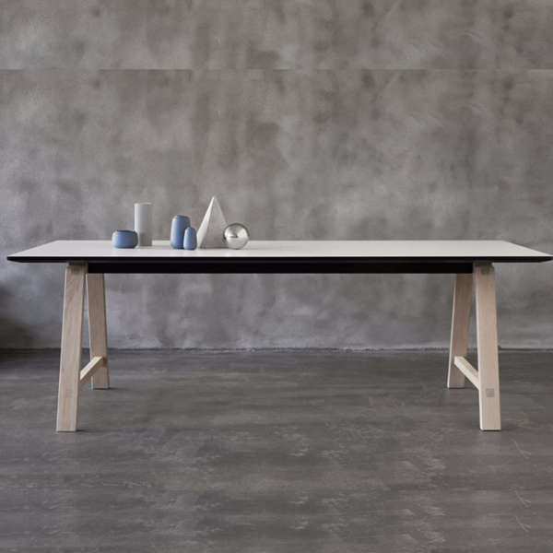
Dining Table Artemis
3100
Dining Table Artemis
Table Top Laminated MDF Board with Linoleum Edge
Dining Table Leg
Dining Table Crossbar
Dining Table Top Support Piece
Dining Table Legs Crossbar
Mount
M3100
M3110
M3120
M3130
M3140
300050
MDF Uncoated Board 1
MDF Uncoated Board 2
Glue
Laminate Sheet (1500 x 1500)
Linoleum Strip
Cut and Glue
M3920
M3920
300120
M3950
M3950
300010 / 300120
MDF Board
Cut
MDF Board
Cut
M3925
300010
M3925
300010

Slide 36
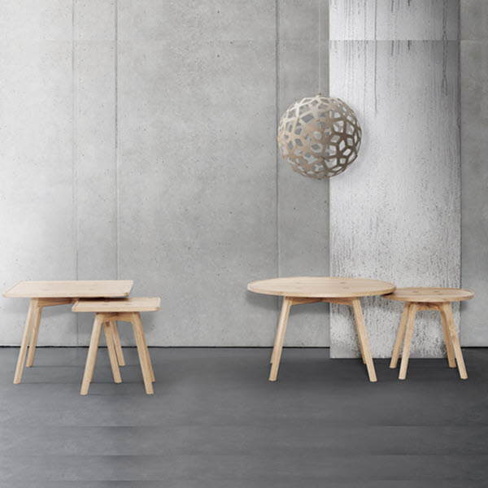
Side Table Hera
3110
Side Table Hera

Slide 37
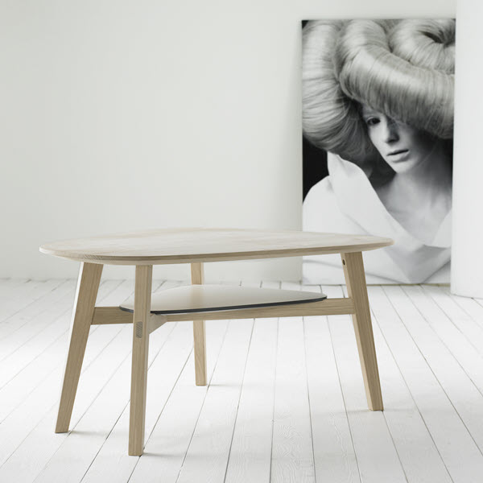
Coffee Table Athena
3120
Coffee Table Athena
Table Top Massive Wood Oval Shaped
Coffee Table Leg
Coffee Table Crossbar Short
Coffee Table Crossbar Long
Table Shelf Oval MDF Board Laminated
Mount
M3105
M3115
M3125
M3125
M3102
300050
MDF Uncoated Board
Laminate Sheet (1500 x 1500)
Glue
Fretsaw
Linoleum Strip
Glue
M3920
M3950
300120
300140
M3970
300120
MDF Board
Cut
M3925
300010

Slide 38

Sofa Helios
3200 and 3210
Sofa Helios
Upholstered Sofa Seat
Sofa Legs Frame Helios
Sofa Pillow
Mount
M3200
M3210
M3240
300050
Sofa Frame without Foam Top Part
Sofa Frame without Foam Bottom Part
Sofa Foam Parts
Glue
Leather or Fabric
Cutting and Upholster
M3220
M3220
M3230
300120
M3910 / M3900
300010 / 300100

Slide 39
Sofa Helios
3200 and 3210
Sofa Helios
Upholstered Sofa Seat
Sofa Legs Frame Helios
Sofa Pillow
Mount
M3200
M3210
M3240
300050
Basic Seat Pillow
Leather or Fabric
Cut and Sew
M3290
M3910 / M3900
300010 / 300080

Slide 40
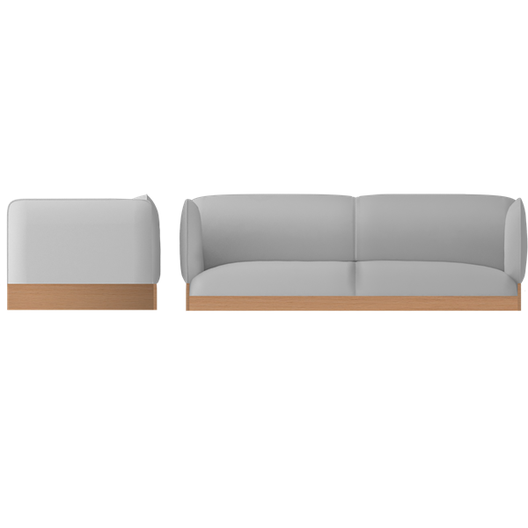
Sofa Apollo
3220 and 3230
Sofa Apollo
Upholstered Sofa Seat
Sofa Legs Frame Apollo
Mount
M3200
M3215
300050
Sofa Frame without Foam Top Part
Sofa Frame without Foam Bottom Part
Sofa Foam Parts
Glue
Leather or Fabric
Cutting and Upholster
M3220
M3220
M3230
300120
M3910 / M3900
300010 / 300100

Slide 41
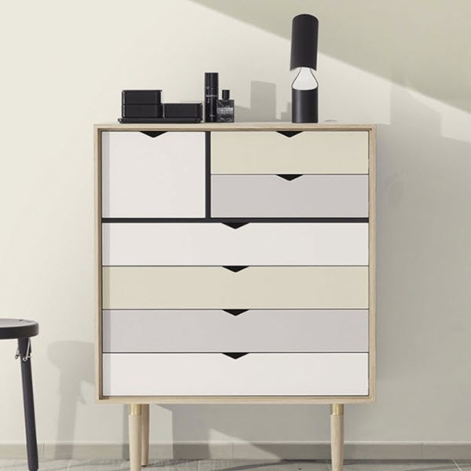
Storage Cabinet Nemesis
3300
Storage Cabinet Nemesis
MDF based Panel Nemesis
Top/Right/Left/Bottom
Compartment Separator Melamine
Horizonal/Vertical
Back Plate Masonite
Drawer Nemesis
1 - 7
Storage Cabinet Nemesis Leg
Mount
M3300
M3310
M3320
M3350
M3390
300050
MDF Uncoated Board
Veneer Strips
Veneer
Drill
Mill
M3920
M3960
300110
300020
300030
MDF Board
Cut
M3925
300010

Slide 42
Storage Cabinet Nemesis
3300
Storage Cabinet Nemesis
MDF based Panel Nemesis
Top/Right/Left/Bottom
Compartment Separator Melamine
Horizonal/Vertical
Back Plate Masonite
Drawer Nemesis
1 - 7
Storage Cabinet Nemesis Leg
Mount
M3300
M3310
M3320
M3350
M3390
300050
Chipboard Melamine 10 mm (2000 mm x 2000 mm)
Cut
Drill
Linoleum Strip
Glue
M3930
300010
300020
M3970
300120

Slide 43
Storage Cabinet Nemesis
3300
Storage Cabinet Nemesis
MDF based Panel Nemesis
Top/Right/Left/Bottom
Compartment Separator Melamine
Horizonal/Vertical
Back Plate Masonite
Drawer Nemesis
1 - 7
Storage Cabinet Nemesis Leg
Mount
M3300
M3310
M3320
M3350
M3390
300050
MDF Uncoated Board
Linoleum Strip
Cut
Glue
Cut
Drawer Parts Nemesis (Melamine) Top/Right/Left/Bottom
Drawer Soft Closing Mechanism
Mount
M3920
M3970
300010
300120
300010
M3920
M3920
300050
MDF Board
Cut
Chipboard Melamine 10 mm
Setup Cutting Machine
Cut
M3925
300010
M3930
O300010
300010

Slide 44
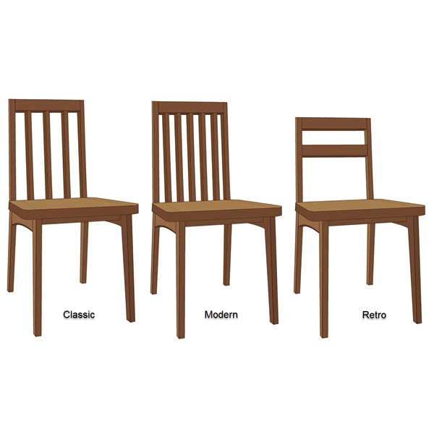
Chair Castor
5000
Chair Castor
Chair Seat
Chair Legs
Front/Back
Chair Top Piece
Chair Bar
Mount
Lacquer RAL
Oil
Surface Treatment
M3005
M3010
M3020
M3030
300050
M3990
M3995
300060
Chair Seat Back Piece
Chair Seat Front Piece
Chair Seat Sides
Chair Seat Wood (Foam)
Fabrics or Leather
Cut and Upholster
Mount
M3025
M3040
M3045
M3050 / M3055
M3900 / M3910
300010 / 300100
300050

Slide 45
Chair Pollux
5010
Chair Pollux
Chair Seat
Chair Legs
Front/Back
Chair Top Piece
Chair Bar
Mount
Lacquer RAL
Oil
Surface Treatment
M3005
M3010
M3020
M3030
300050
M3990
M3995
300060
Chair Seat Back Piece
Chair Seat Front Piece
Chair Seat Sides
Chair Seat Wood (Foam)
Fabrics or Leather
Cut and Upholster
Mount
M3025
M3040
M3045
M3050 / M3055
M3900 / M3910
300010 / 300100
300050

Slide 46
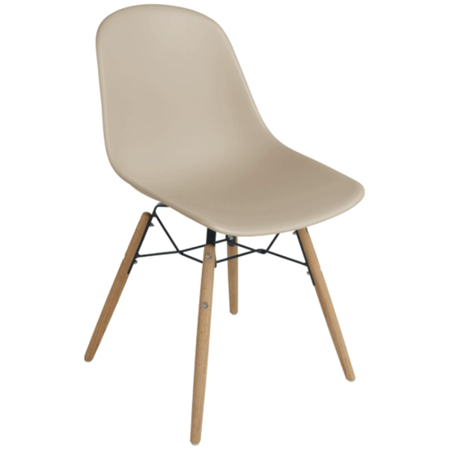
Chair Hephaestus
5020
Chair Hephaestus
Bucket Chair Seat
Screw M8
Mounted Chair Frame
Mount
M3060
SCREWM08
M3065
300050
Granulate
Setup Molding Machine
Mold
Chair Leg
Chair Frame- Bottom
Screw M4
Bolt M4
Mount
M3980
O300040
300040
M3010
M3015
SCREWM04
BOLTM04
300040

Slide 47
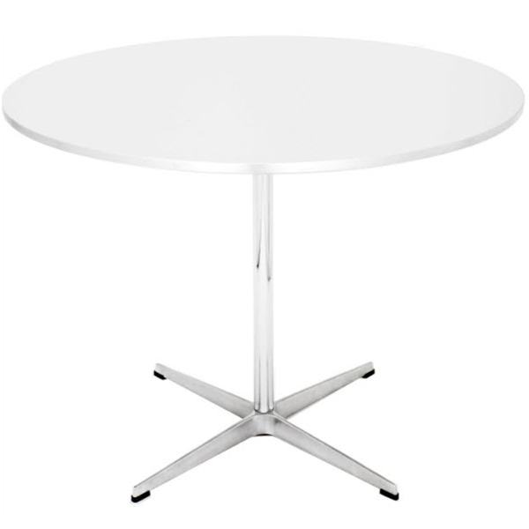
Cantina Table Circe
5100
Cantina Table Circe
Table Top Veneered, Round
Aluminum Table Base
Mount
M3108
M3150
300050
MDF Uncoated Board
Veneer Strips
Setup Veneer Press
Veneer
M3920
M3960
O300090
300110
MDF Board
Cut
M3925
300010

Slide 48
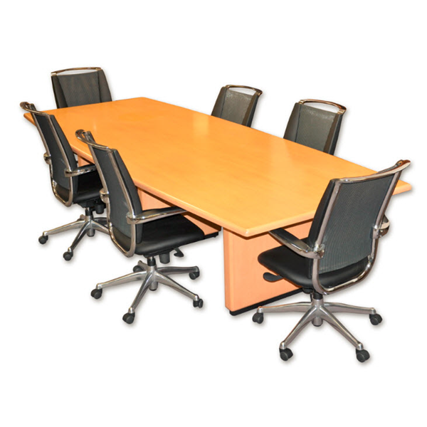
Conference Table Calypso
5110
Conference Table Calypso
Table Top Veneered, Rectangular
Table Base Wood, Veneered
Mount
M3107
M3160
300050
MDF Uncoated Board
Glue
Waiting Time Glue
Veneer Strips
Setup Veneer Press
Veneer
M3920
300120
O300120
M3960
O300090
300110
MDF Board
Cut
M3925
300010

Slide 49
Conference Table Calypso
5110
Conference Table Calypso
Table Top Veneered, Rectangular
Table Base Wood, Veneered
Mount
M3107
M3160
300050
Table Base Wood, Basic
Veneer Strips
Veneer
M3165
M3960
300110

Slide 50
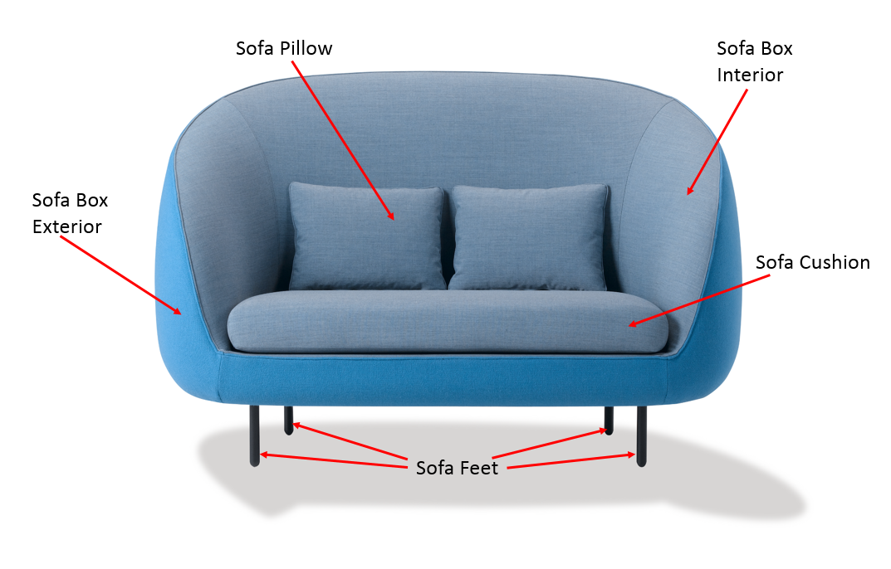
5200 and 5210

Slide 51
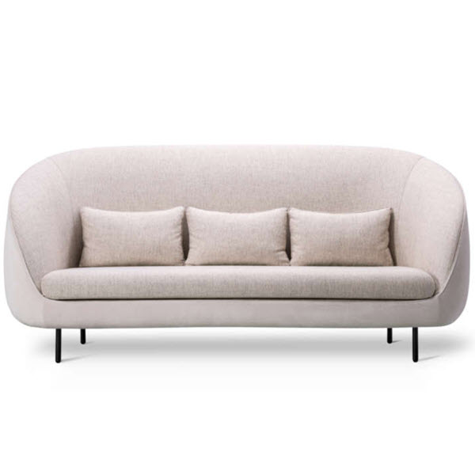
Sofa Persephone
5200
Sofa Persephone
FRAME
CUSHION
PILLOW
Sofa Frame without Foam
Sofa Foam Parts
Sofa Box Exterior Material
Cut
Sofa Fabric Pattern/Color
Cut and Upholster
Sofa Foam Parts
Sofa Fabric Pattern/Color
Cut and Sew
Sofa Pillow
Sofa Feet
M3220
M3230
M3250
300010
M3905
300010 / 300100
M3230
M3905
300010 / 300080
M3240
M3260
Basic Seat Pillow
Leather or Fabric
Cut and Sew
M3290
M3910 / M3900
300010 / 300080

Slide 52
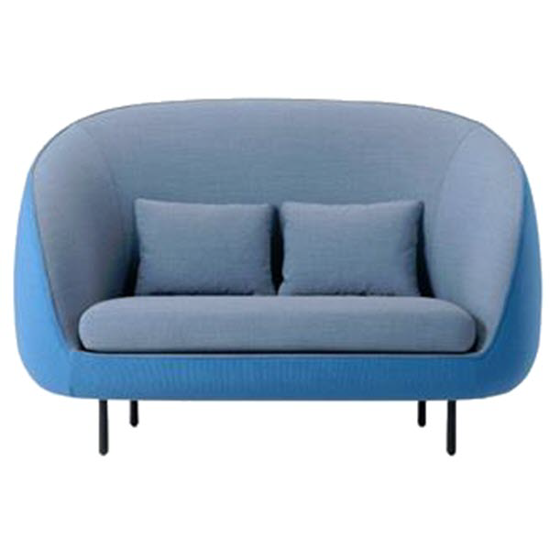
Sofa Dyonisos, 2-Seater
5210
Sofa Dyonisos, 2-Seater
FRAME
CUSHION
PILLOW
Sofa Frame without Foam
Sofa Foam Parts
Sofa Box Exterior Material
Cut and Uphol-ster
Sofa Fabric Pattern/Color
Cut and Upholster
Sofa Foam Parts
Sofa Fabric Pattern/Color
Cut and Sew
Sofa Pillow
Sofa Feet
M3220
M3230
M3250
300010/300100
M3905
300010 / 300100
M3230
M3905
300010 / 300080
M3240
M3260
Basic Seat Pillow
Leather or Fabric
Cut and Sew
M3290
M3910 / M3900
300010 / 300080

Slide 53
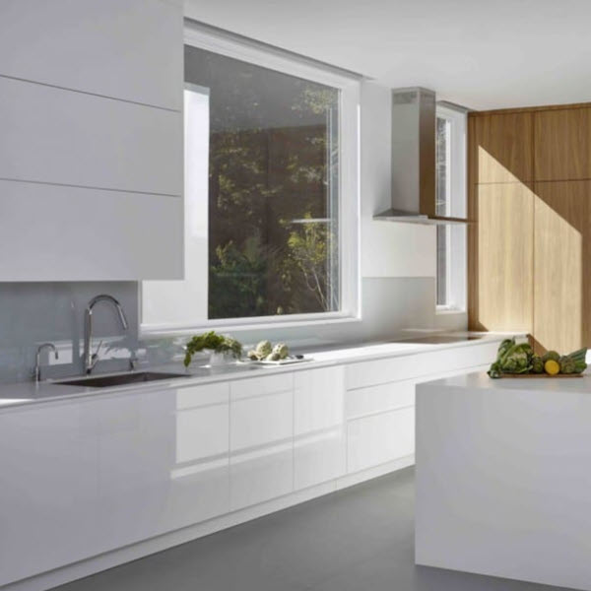
Kitchen Cabinet Hestia
5300
Kitchen Cabinet Hestia
Chipboard based Panel Hestia
Bottom/Left/Right
Top Pieces Hestia (Pine)
Back/Front
Cabinet
Door Hestia
Cabinet
Door Hinge
Back Plate Masonite
Shelf Cabinet Hestia
Drawer Hestia
1 - 5
Cabinet Handle
Leveling Leg Kitchen Cabinet
Mount
M3305
M3330
M3340
M3385
M3320
M33455
M3355
M3375
M3395
300050
Chipboard Melamine 10 mm
Setup for Cutting Machine
Cut
Setup for Drilling Machine
Drill
Setup for Milling Machine
Mill
M3930
O300010
300010
O300020
300020
O300030
300030

Slide 54
Kitchen Cabinet Hestia
5300
Kitchen Cabinet Hestia
Chipboard based Panel Hestia
Bottom/Left/Right
Top Pieces Hestia (Pine)
Back/Front
Cabinet
Door Hestia
Cabinet
Door Hinge
Back Plate Masonite
Shelf Cabinet Hestia
Drawer Hestia
1 - 5
Cabinet Handle
Leveling Leg Kitchen Cabinet
Mount
M3305
M3330
M3340
M3385
M3320
M33455
M3355
M3375
M3395
300050
Wood Pine (5 cm x 20 cm x 200 cm)
Cut
Drill
M3930
300010
300020

Slide 55
Kitchen Cabinet Hestia
5300
Kitchen Cabinet Hestia
Chipboard based Panel Hestia
Bottom/Left/Right
Top Pieces Hestia (Pine)
Back/Front
Cabinet
Door Hestia
Cabinet
Door Hinge
Back Plate Masonite
Shelf Cabinet Hestia
Drawer Hestia
1 - 5
Cabinet Handle
Leveling Leg Kitchen Cabinet
Mount
M3305
M3330
M3340
M3385
M3320
M33455
M3355
M3375
M3395
300050
MDF Uncoated Board
Setup for Cutting Machine
Cut
Laminate Sheet
Glue
Cut
Linoleum Strip
Glue
M3920
O300010
300010
M3950
300120
300010
M3970
300120
MDF Board
Cut
M3925
300010

Slide 56
Kitchen Cabinet Hestia
5300
Kitchen Cabinet Hestia
Chipboard based Panel Hestia
Bottom/Left/Right
Top Pieces Hestia (Pine)
Back/Front
Cabinet
Door Hestia
Cabinet
Door Hinge
Back Plate Masonite
Shelf Cabinet Hestia
Drawer Hestia
1 - 5
Cabinet Handle
Leveling Leg Kitchen Cabinet
Mount
M3305
M3330
M3340
M3385
M3320
M33455
M3355
M3375
M3395
300050
Chipboard Melamine 10 mm
Setup Cutting Machine
Cut
Linoleum Strip
Glue
M3930
O300010
300010
M3970
300120

Slide 57
Kitchen Cabinet Hestia
5300
Kitchen Cabinet Hestia
Chipboard based Panel Hestia
Bottom/Left/Right
Top Pieces Hestia (Pine)
Back/Front
Cabinet
Door Hestia
Cabinet
Door Hinge
Back Plate Masonite
Shelf Cabinet Hestia
Drawer Hestia
1 - 5
Cabinet Handle
Leveling Leg Kitchen Cabinet
Mount
M3305
M3330
M3340
M3385
M3320
M33455
M3355
M3375
M3395
300050
Drawer Front (MDF Coated)
Drawer Soft Closing Mechanism
Drawer Parts Hestia (Melamine)
Left/Right/Back/Bottom
Mount
M3370
M3380
M3365
300050
MDF Uncoated Board
Laminate Sheet
Cut
Linoleum Strip
Glue
Chipboard Melamine 10 mm
Setup Cutting Machine
Cut
M3920
M3950
300010
M3970
300120
M3930
O300010
300010
MDF Board
Cut
M3925
300010

